Slide 1


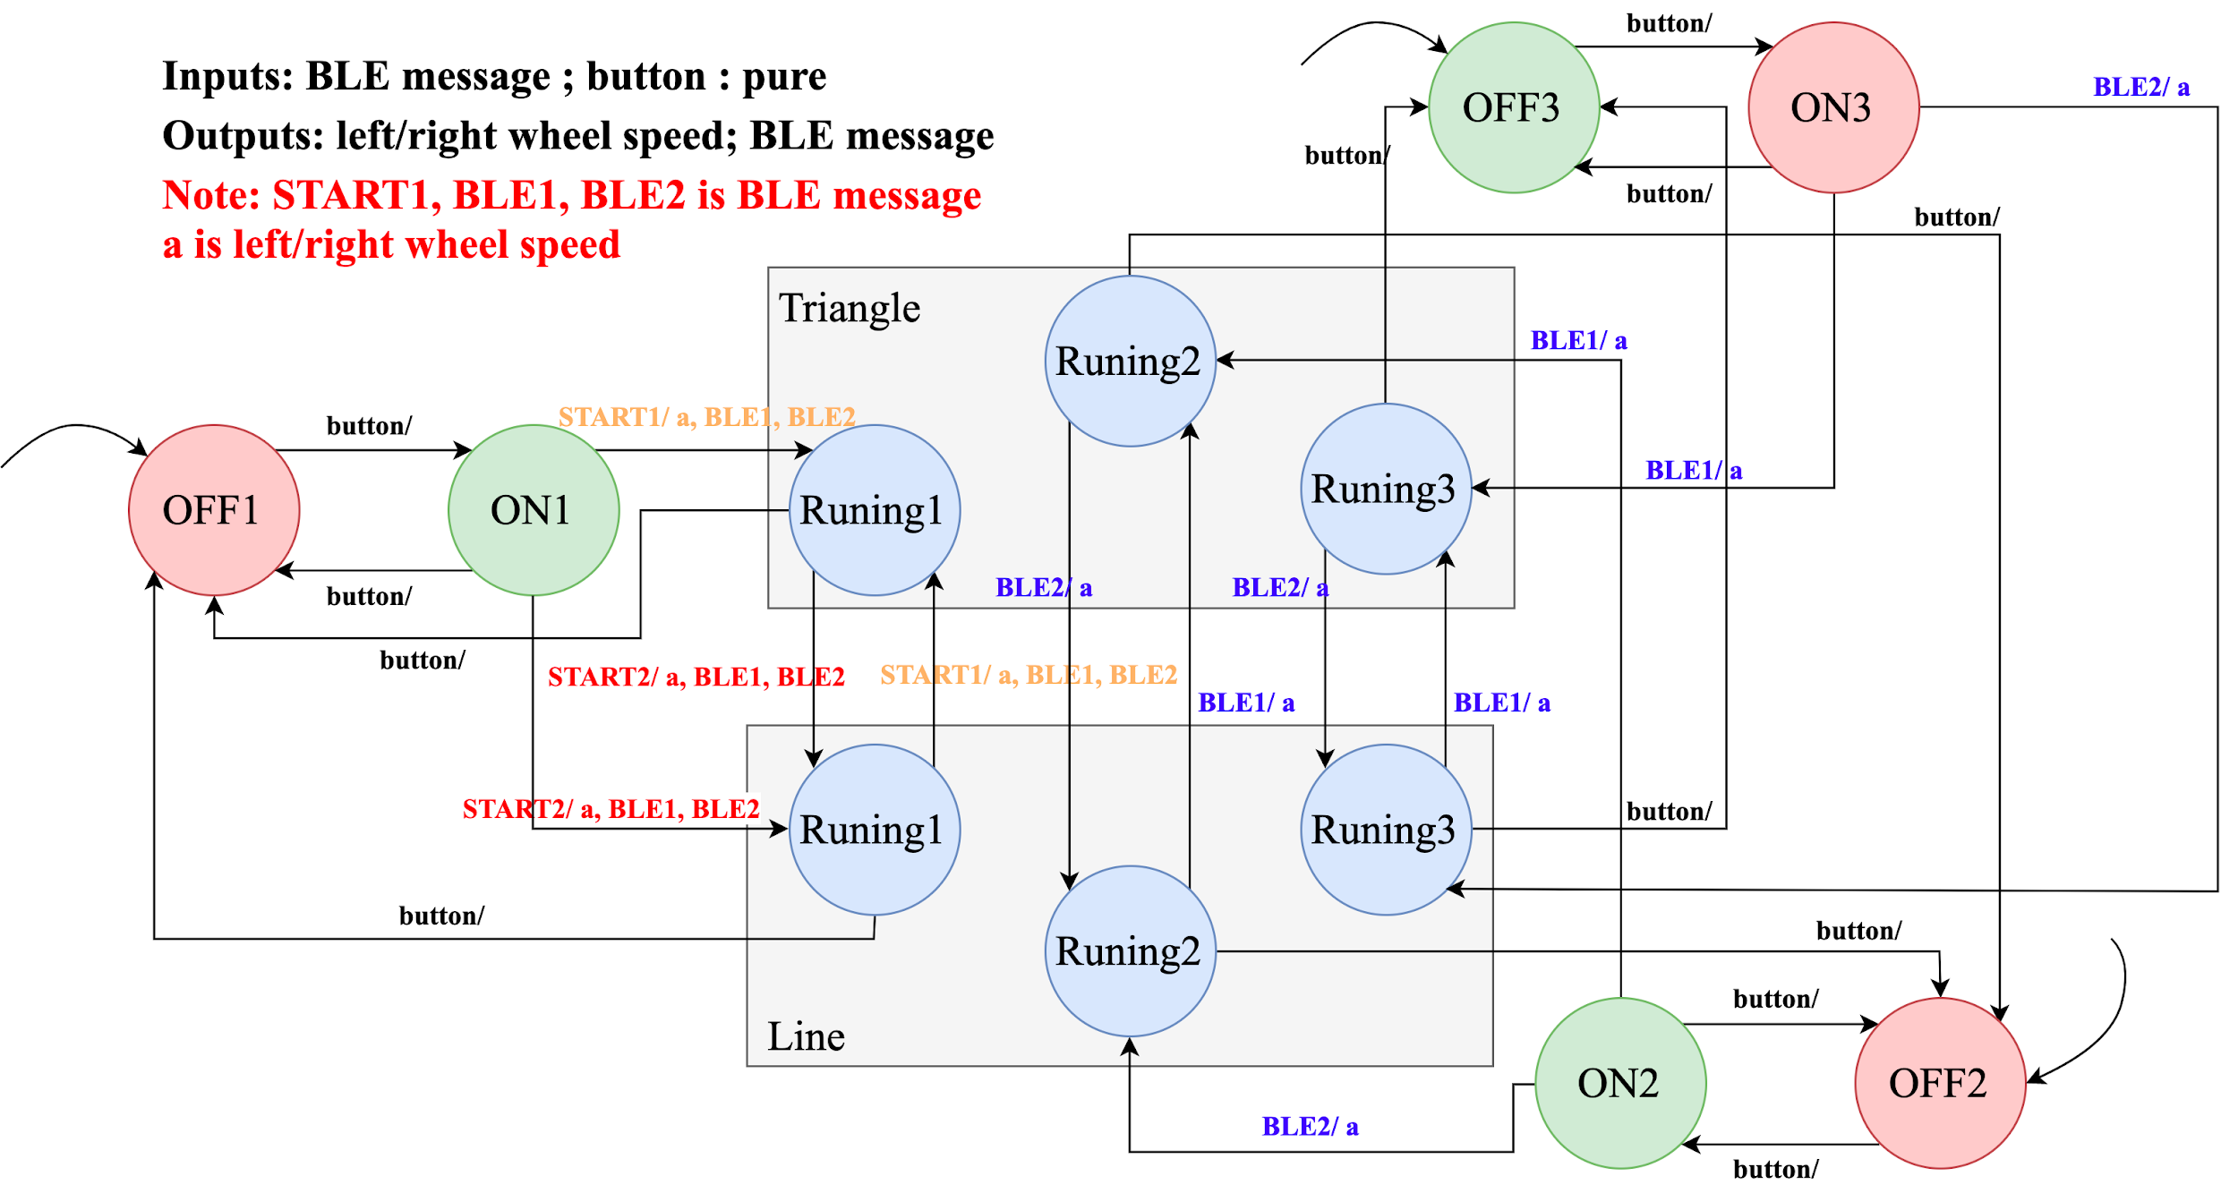
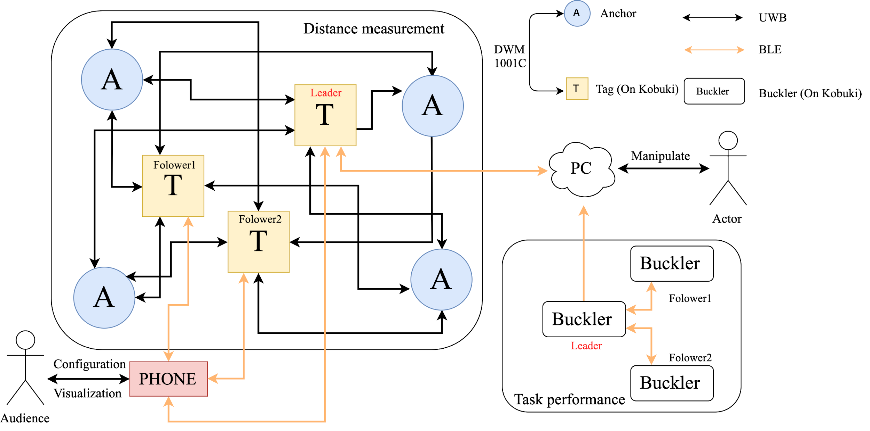
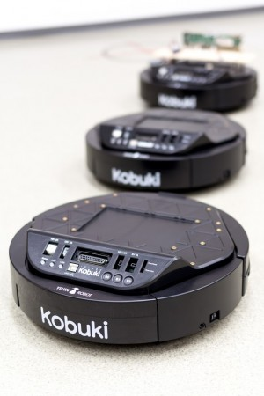
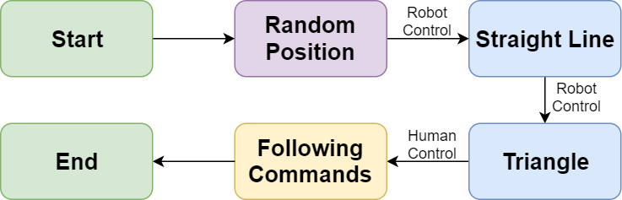
Tri-Robot Cooperation
2019
Zhaoyang Chen | Jieming Fan | Manqin Zhong | Bingjie Zhu
Hardware Architecture
BLE communication
Actor manipulates computer by pressing to start and to control Kobuki’s. Eventually, the command is sent to the Leader Kobuki via BLE, and then Leader Kobuki will advertise the commands via BLE to other Kobuki’s to realize communications between each other.
UWB communication
We will utilize the UWB device (DWM 1001C) to form the distance measurement system to measure the distance between each Kobuki. We apply a “4 anchors + 3 Tags ” system in
+o
State Machine & Task Route
our project, with 4 anchors set in Cory 204 and 3 tags placed on Kobuki’s. When each tag transmit signals to the anchors, we can easily get the actual position in the coordinate system established by the anchors.
Implementation
Hardware
Nordic nRF52832 Development Kit
DWM1001C ultra wideband transceivers used to get position of each robot
Berkeley Bulkers
Kobuki’s as robots to achieve basic robot movements
Software
Buckler repo
BLE libraries for connections between human and leader Kobuki, leader Kobuki and other followers
NRF SDK
SPI interface to export data from sensors to computers
Project Goal
Core Algorithm
Tri-Robot Cooperation focused on cooperative robots. It was created to be self-controllable, intelligent and accessible to human control.
Cooperation
Create a self-control system between robots
Construct internal connections without human control
Interaction
Bridge gap between humans and robots
Integrate intuitive human interface (key control) into robotic movements
Practical purpose
Potential use in package delivery and logistic industry
Evaluation
Connections to Course Topics
State Machines
Kobuki internal control system is a heavily modified variant of state-machine based Kobuki control system from lab
Sensors and Actuators
Ultra wide band (UWB) transceiver: Position sensor via ultra wide band.
Kobukis (sensors & actuators): Internal sensors used for positioning, motors used for movement
Networking and Communications
Bluetooth low energy (BLE): Internal Control System to Kobuki communication and Human Control system are established through BLE, had to find appropriate with Bluetooth advertisement windows.
Input and Output
Analog inputs for sensor readings, serial peripheral interface (SPI) ports to read data

